Slide 1
Blood Donation System (LifeSource)
CS - 7313 Advanced Database Management System Project
Presented By : Group - 2
(Software Engineering)

Slide 2

Group Members
1
Nyan Ye Thu
4SE - 1923
Myint Theingi Tun
4SE - 1187
2
Sithu Aung
4SE - 1114
3
Kay Zin Thant
4SE - 1162
4
Aye Chan Phyu
4SE - 1167
5

Slide 3
01.
System Introduction
02.
Database Schema
03.
ER Diagram
Contents
04.
Languages
05.
Why MariaDB?
06.
Testing

Slide 4
01.
System Introduction

Slide 5
LifeSource is an open source blood donation platform that connects blood seekers with blood donors. Our system helps those in need of blood to find donors with ease in all regions.
Motive
Finding blood donors has become difficult and problem for many, and sometimes it can be a problem of life and death, this thing has motivated to find a solution to it.
Vision
You need blood donor? A quick search on this platform gives you access to thousands of donors near you.

Slide 6
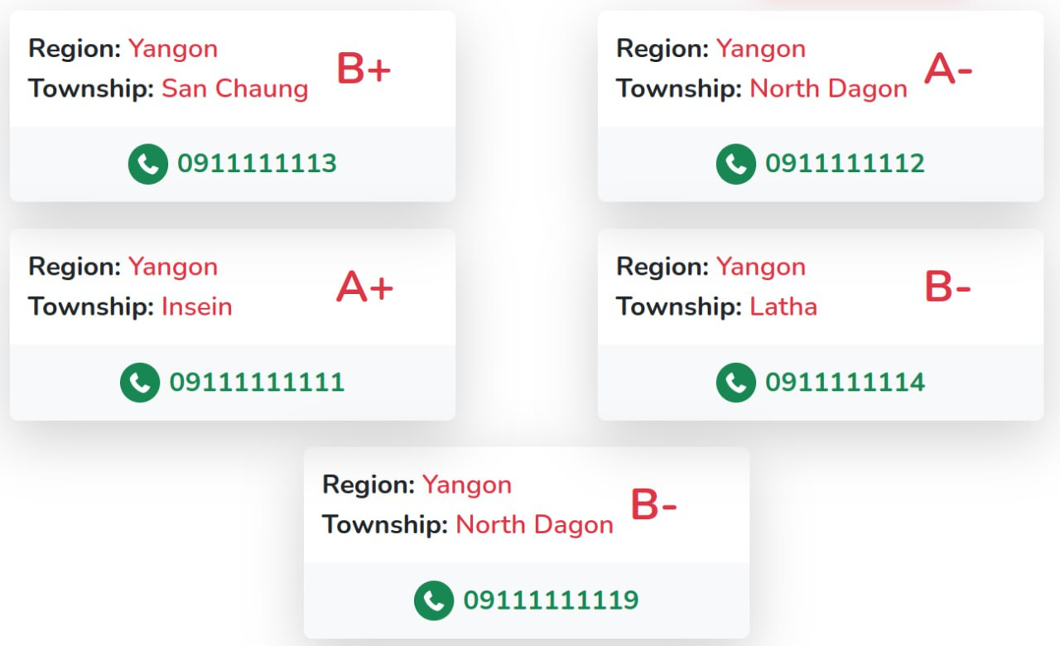
How it works ?
For blood donors: they register using their phone number, blood group, address.

Slide 7
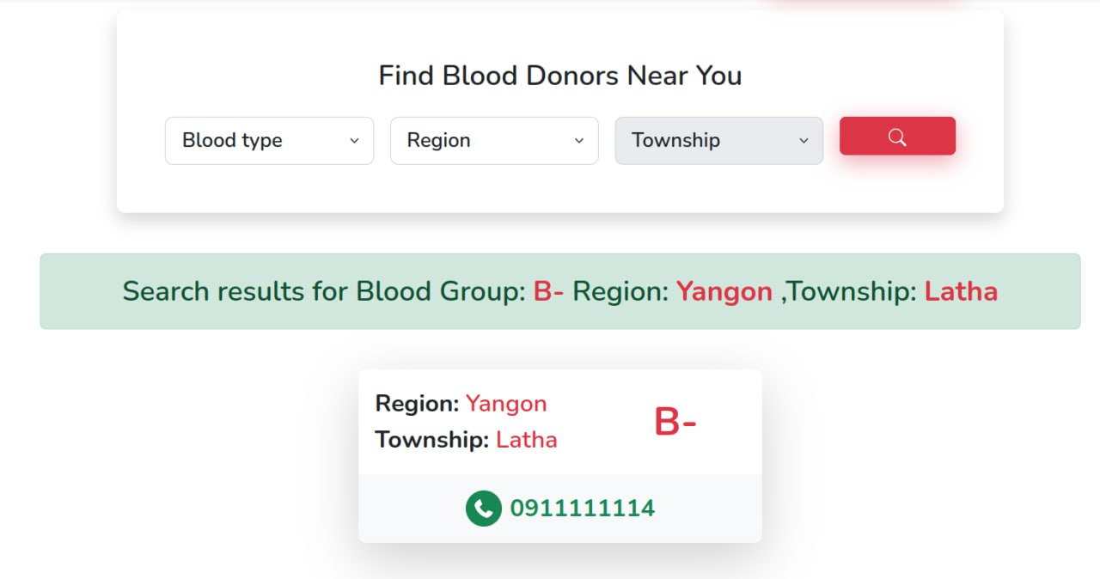
How it works ?
For blood seekers: they do a quick search where they choose the blood group and the region, then they will get a list of donors with their phone number.

Slide 8
02.
Database Schema

Slide 9
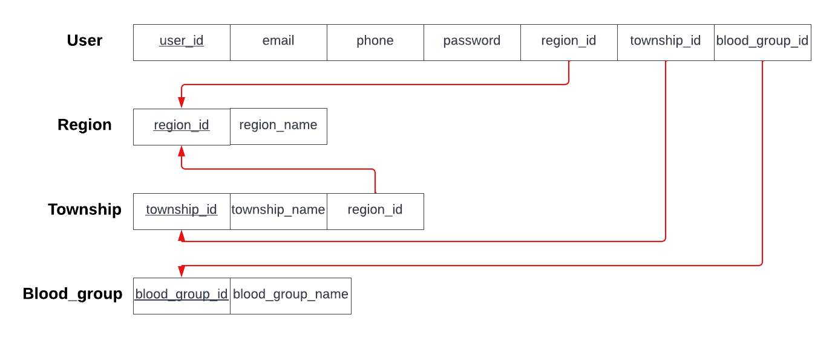

Slide 10
03.
ER Diagram

Slide 11
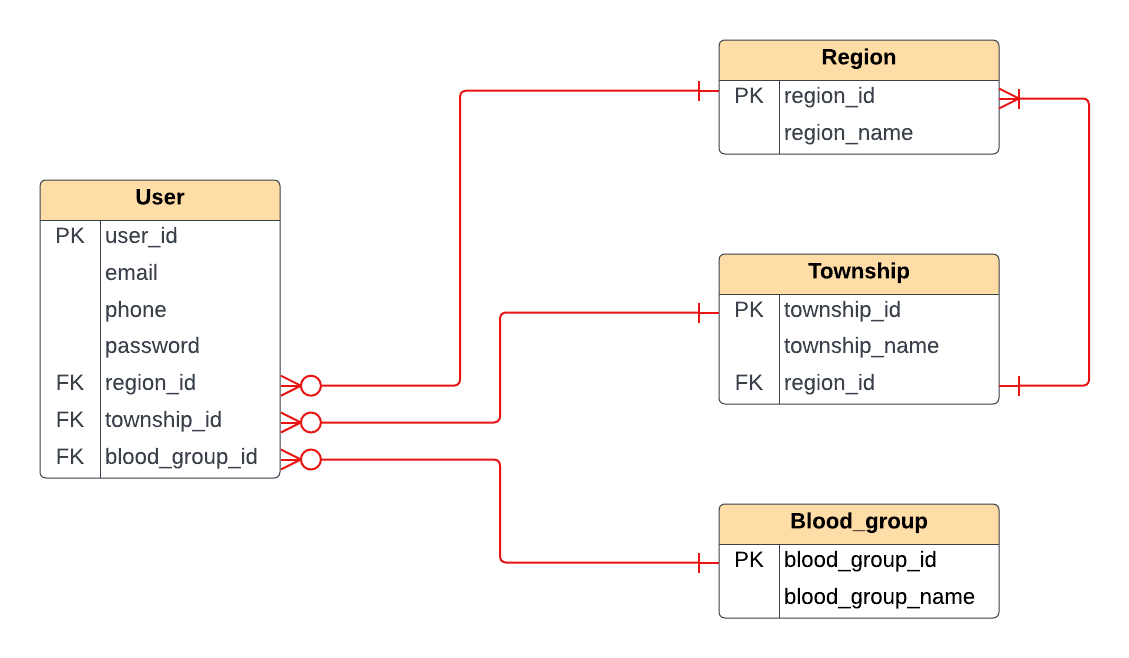

Slide 12
04.
Languages and Database

Slide 13
Languages
PHP (Laravel)
JavaScript
Laravel Blade
CSS
Databases
MariaDB

Slide 14
05.
Why MariaDB ?

Slide 15
Maria DB (Comparison with MySQL)
MariaDB offers more and better storage engines.
MariaDB allow to run SQL and NoSQL in a single database system.
MySQL database engine InnoDB are replaced in MariaDB by Aria.
Temporary table also use Aria, which speeds up complex queries such as GROUP BY and DISTINCT.
MariaDB enhances the KILL command to allow to kill all queries for a user (KILL USER username) or to kill a query ID (KILL QUERY ID query-id).
In addition, in the latest Red Hat 7 release, MariaDB replaces MySQL in the default software repository.
A large number of former MySQL users, including Wikipedia, have migrated t MariaDB, in the process have gained a modern, stable, powerful, and fast database system.

Slide 16
06.
Let’s Test Together …

Slide 17
References
https://mariadb.com/resources/blog/why-should-you-migrate-from-mysql-to-mariadb/
https://www.hostinger.com/tutorials/mariadb-vs-mysql

Slide 18


Slide 19
Thank You For Your Attention…

